Slide 1
Foundations of Thought Leadership
Reframing Your Narrative
Notes:
Hello everyone! And welcome to Foundations of Thought Leadership - Reframing Your Narrative
[ADD INFORMATION ABOUT YOURSELF AND WHAT YOU DO]
In this workshop today, we’re going to explore the source of credibility and how to establish it. We’ll spend time thinking through how you can re-contextualize your own strengths, skills, and experiences and how all this factors the unique value you provide. You’ll walk away from this hour with a first draft of a bio you can use for your LinkedIn, professional website, cover letter or wherever you’re looking to share who you are and why you’re amazing. So - let’s get into it, we have a LOT to get through, but it’s going to be fun.

Slide 2

Notes:
Today’s workshop was crafted by Write/Speak/Code -- which was founded in 2013 to be a safe space for professional women, non-binary and trans technologists to explore thought leadership through writing blogs and books, speaking at conferences and contributing to open source software projects.
Women Techmakers has partnered with Write/Speak/Code to present this workshop because of each organizations shared commitment to fostering visibility, community and developing resources for people with marginalized gender identities in tech.

Slide 3
Today’s goal
Get comfortable telling your story by writing a professional bio
Text & diagram slides
Notes:
We’ll be focusing on one primary goal today - to get you comfortable talking about yourself, your expertise and telling your story through writing a new professional bio.

Slide 4
During this training feel free to...
Ask a question
Have a notes app open or piece of paper handy for activities
Take pictures of the slides
Ask me to repeat or rephrase something

Slide 5
Our agreement:
Speak from your experience
Use the chat to share and meet others
Send words (or emojis) of encouragement and recognition
What’s shared here stays here
Be focused, be present and HAVE FUN

Slide 6
Introduce yourself in the chat
😆🥳🧐
🤓😴🤠
One thing you hope to get from this session
One emoji that describes your mood right now

Slide 7
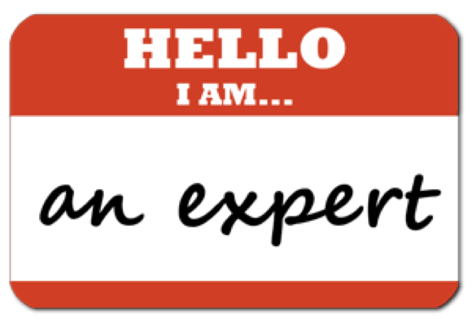
Notes:
Who already has a blog, or is contributing to other publications, speaking at conferences or contributing to open source? You can add a “me” in the chat
[Likely will have some, but not very many responses] I know that this virtual room is teeming with experienced professionals who have plenty to say and share. But why aren’t we sharing our voices? A lot of us feel like we have to be an expert in order for someone to want to read or hear what we have to say - but often we all have a really high bar for what we think an expert is or knows.
Who feels like an expert? Who would feel comfortable wearing this name badge?

Slide 8

Section title can go here
Notes:
This is a phrase I think a lot of us are probably familiar with. I describe it as the “Oh ****! Everyone is going to realize I have NO idea what I’m doing” feeling

Slide 9
What is imposter syndrome?
Inability to internalize accomplishments
“I shouldn’t be here” feeling
Convinced you are a fraud
Notes:
ASK - What does imposter syndrome mean to you? Add your thoughts into the chat
[as presenter - validate the responses you see in the chat]
Imposter Syndrome, is the belief that you’re going to eventually be “found out.” You dismiss success, so the feeling never really goes away.
While it may be more severe for women and other underrepresented minorities, it’s a phenomena that’s experienced across racial and gender lines. Imposter Syndrome is especially acute in professions where people's work is constantly under review by talented peers, such as academia or Open Source Software, or when taking on a new job.

Slide 10
Sound familiar?
It was just a simple bug fix
I only did part of the work, it was mostly my coworker
Well… I guess I’m decent at public speaking
I think this is probably the way we should do this
I was in the right place at the right time - it was good timing
I got lucky with my first programming job
Notes:
ASK - Have you ever used any of the bolded words when talking about your work?
People with impostor syndrome attribute success to external factors and describe accomplishments with qualifiers or self deprecating language “I just happened to be at the right place at the right time.” On the flip side they attribute failure to themselves: ability, effort, “I should have worked harder”

Slide 11
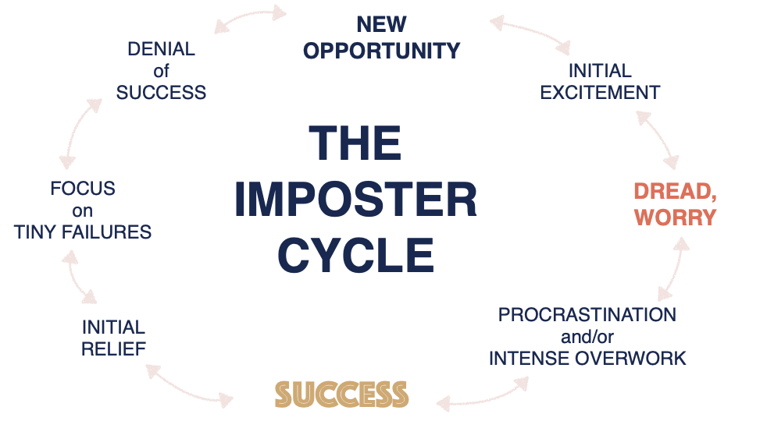
Notes:
Imposter syndrome can be a vicious cycle. You receive a new opportunity and feel initial excitement. Then the worry, dread, panic and fear set in, because you don’t truly believe you deserve that opportunity. So you might either engage in intense overwork or just completely procrastinate until the last second. But here’s the thing -- either way you’re likely to be successful because you’re smart and capable - you were chosen for or approve to do this for a reason.
So initially, you might let out a sign and experience some temporary relief, but quickly you find yourself focusing on tiny flaws in your execution (a typo in your post, stumbling over your words in a section of your talk) and will deem the entire endeavor a failure, thus continuing the cycle. It can be exhausting.

Slide 12
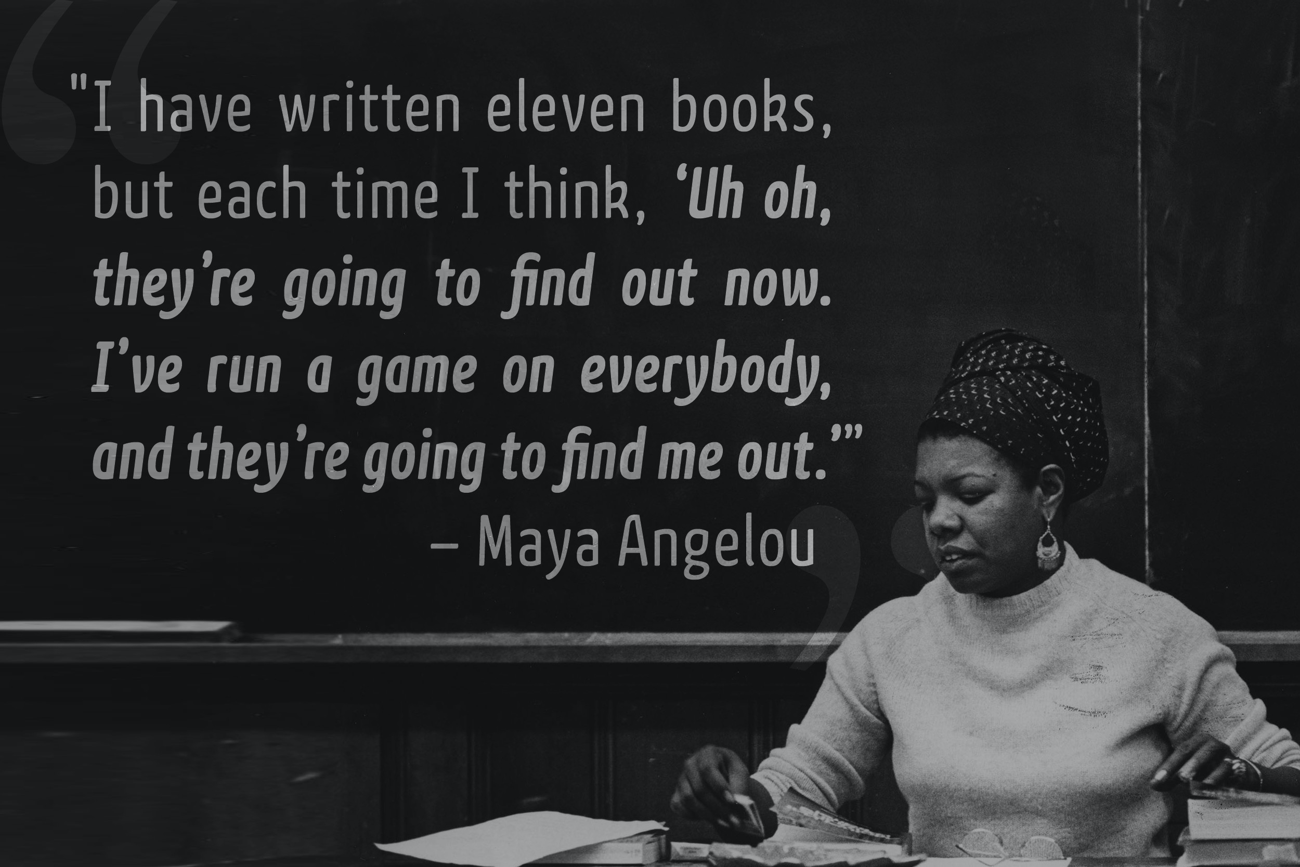
Notes:
[pause to let the audience read the quote] This feeling can be quite pervasive. Even Maya Angelou, arguably one of the most accomplished and prolific writers and poets in history felt this way.

Slide 13
Why does this matter?
Tech is communal
teams, pairing
open source
stack overflow
conferences
books and blogs
Notes:
So why are we spending this time talking about imposter syndrome in the contest of the workshop today? You might be thinking: “Why does it matter that I hold myself back from sharing my own expertise? I’m just one person, it’s not a big deal if I don’t share my voice.”
[CLICK]
It matters because it’s not just your missed opportunity - everyone in the community gets held back because tech is COMMUNAL. It relies on shared knowledge, the hive mind, to push us forward. Some of us work on teams that pair program everyday, most of us have used stack overflow to solve complicated coding challenges, we attend conferences, we read technical books and blogs, if everyone was afraid to share their voice, where would we be as an industry?

Slide 14
So… what do
we do about it?
Notes:
So - if we all feel this way and need to overcome it - what do we do about it?
I’m going to spend the next couple slides talking through a few strategies you can use to combat dealing with imposter syndrome

Slide 15

Option 1:
acknowledge & move forward
“Seriously, I've just realized that almost everyone is a fraud, so I try not to feel too bad about it.” - Tina Fey
Notes:
So option 1 - Tina Fey’s school of Imposter Syndrome - just acknowledge it and move forward.
For some people this “fake it until you make it” strategy can work for them....

Slide 16
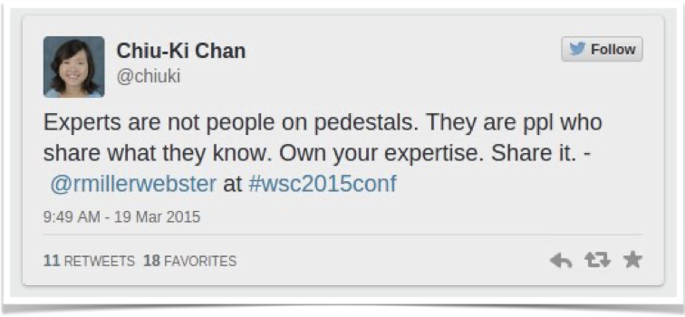
Option 2: Re-contextualize
Notes:
...but for others it can be useful to reframe the conversation, and understand that thought leadership is not about proving yourself (your intelligence or your worthiness) to anyone it’s about sharing what you know with the world. Put differently, it’s a gift you’re giving to other people.

Slide 17
Activity: Write 10 accomplishments
(or more) in 2 minutes
Option 3: Collect the data
Notes:
If you want to counter your own internal critic, It can also be helpful to remind yourself of everything you’ve achieved thus far in your life and career. We call this “Collecting the Data,” because you can’t fix what you don’t measure.
So we’re going to spend the next 2 minutes writing down at least 10 of your accomplishments - and these can be professional or personal. Make sure you’re avoiding the diminishing language we talked about (the “justs” the “luckies”) and owning your accomplishments

Slide 18
Activity: Write 10 accomplishments
(or more) in 2 minutes
Share an accomplishment in the chat
Option 3: Collect the data
Notes:
Now let’s share in the chat - don’t be shy, just copy and paste one of your accomplishments and put it in there
That can feel intimidating, right? Even though this is a technique we can use to counter imposter syndrome, it’s a little daunting to share what you’re good at in a public forum. But these accomplishments are AMAZING. And when we share our accomplishments and get positive feedback (as we most likely will) it’s also important to get good at receiving that praise.
But let’s all practice really quickly - I’m going to compliment your accomplishment, and you’re either going to say (to your screen) “Thank you” or if you want to practice some fierce confidence, “I know right?”
OK ready? “Wow, what an amazing accomplishment, you are so great!”

Slide 19
Activity: Write 5 (or more) things related to tech that you can teach
Option 4: Teach what you know
Notes:
A final option is to teach what you know --
Often you might not even recognize how much you know about a topic until you start explaining or teaching it to someone else. So now I want you to spend 1 minute writing down anything related to tech that you could teach - it can be super small and specific or broad.
Optional - chat share

Slide 20
Let’s take it a step further...
Notes:
So now you have a number of practical ways that you can work to counter the feeling of imposter syndrome, which can help you feel less like an imposter and more like an expert.
But let’s now take that a step further - what does it mean to be an expert - what gives someone credibility? Share a couple words in the chat [read some of what is shared in the chat]

Slide 21
Crafting credibility
What gives someone credibility?
knowledge - what you know
experience - what you’ve done, who you know
shiny bauble - an impressive fact that’s unique to you
What do I need to know about you to trust what you have to say?
Notes:
[CLICK]
There are 3 primary factors in building credibility: knowledge (what you know), experience (what you’ve done and who you know) and what we’re calling a “shiny bauble” (an impressive fact that’s unique to you, people can have several) → all of which answers the question “What do I need to know about you to trust what you have to say?”

Slide 22
Crafting credibility
What’s your shiny bauble? It’s all about street cred...
Identify and write 5:
results you’ve created
awards/honors
mainstream press
impressive institution you’ve been associated with
formal education or training you’ve had
Notes:
We’ll dig more into everything that goes into knowledge and experience in just a second, but let’s start with the shiny bauble -- what is impressive about you?
This can be: results from projects you’ve worked on, any award or honor you may have received, education or training you’ve gone through or a number of other things.
Take 1 minute and write down 5 - you can pull from the list of accomplishments you just wrote down
[give 1 min]
Great - so I’m hoping you’re feeling a sense of accomplishment and pride as you wrote down your shiny baubles, because I want you to take those emotions into the next part of our exercise, which is the main goal for today --

Slide 23
Writing your bio
Notes:
Let’s start writing our bios
Who already has a professional bio?
And who out of you have updated it in the past 3 months?
Our bio is always going to be changing as we build knowledge and experience, so for today, even if you have a bio, let’s start from scratch

Slide 24
What to include
Include all parts of you!
roles
skills
strengths
experiences
values
Notes:
You want to include ALL parts of you in a bio - we’re going to dive into each of individually, exploring what makes you a unique asset to the industry, from the roles you’ve had to the values you hold

Slide 25
Roles
What are your roles on your team / organization / projects?
Activity: List as many as you can in 1 min
Tech lead
Facilitator
Project manager
Designer
Enabler
Notes:
[READ SLIDE AND GIVE 1 MIN]

Slide 26
Skills
What do you know?
Activity: List as many as you can in 1 min
languages (HTML, Java, PHP)
frameworks (django, angular, rails etc.)
tools (WordPress)
documentation, testing, project management, etc.
Notes:
[READ SLIDE AND GIVE 1 MIN]

Slide 27
Strengths
What do you consider your strengths? What do others highlight in feedback sessions?
Activity: List as many as you can in 1 min
Bug fixer
Leader
Pioneer of process
Alignment
Keeper of context
Notes:
[READ SLIDE AND GIVE 1 MIN]

Slide 28
Experiences
What have you done?
Activity: List as many as you can in 1 min
jobs, internships, apprenticeships
organizations you’re affiliated with
schools/education/certifications
projects (work or personal)
Notes:
[READ SLIDE AND GIVE ~2 MIN]

Slide 29
Values
What values are most meaningful to you?
Activity: Choose 5 and explain why for each (2 mins)
Notes:
What values are most meaningful to you? I’m going to show a list of a lot of values and I’d like you to choose your top 5 and explain WHY for each - you can select anything - they don’t have to be on this list.

Slide 30
accomplishment
adventure
challenge
community
compassion
competition
cooperation
courage
creativity
decisiveness
efficiency
excellence
fairness
family
free time
friendships
growth
helping others
honesty
independence
inner harmony
integrity
introspection
justice
knowledge
leadership
loyalty
meaningful work
mentorship
persistence
recognition
security
self-knowledge
self-reliance
self-respect
stability
truth
will-power
Notes:
What values are most meaningful to you? I’m going to show a list of a lot of values and I’d like you to choose your top 5 and explain WHY for each - you can select anything - they don’t have to be on this list.
[2 MINS]

Slide 31
Let’s dig a little deeper...
Activity: choose one of the following thought starters and spend 3 minutes writing down anything that comes to mind
As developers/designers/etc we should do more of _____
Something I can teach and why it’s useful
An important lesson I’ve learned in my career
What do you know now that you didn't know a year ago?
A personal quality that has made me successful in my career
Notes:
Let’s get some creative writing flowing now -- I want you to select ONE prompt from the choices below. Write down ANYTHING that comes to mind from the prompt - don’t edit yourself, just write continually for 3 minutes

Slide 32
Review time!
Activity: From each of your lists, what are you...
Most excited about?
Most proud of?
Want to use in the future?
Are there recurring threads or themes…?

Slide 33
Before we jump in….
SHOW don’t tell. Descriptive language is everything
Are you a “creative leader that consistently meets stated goals”
or do you
harness ideas, wrangle agile teams, obsess over cultivating an inclusive culture, and shepherd junior developers through mentorship and masterful coaching?
Activity: rephrase the strengths, skills and experiences you highlighted in your review using active and engaging language
Notes:
When writing a bio, you want the information about yourself to be clear, but you also want to have your unique voice. Don’t end up sounding just like a job description in your bio
When you use descriptive language you allow your readers to engage with your content in a more intimate way and gives insight into the your personality.
You shouldn’t just say you’re “creative,” -- you should reference specific projects they worked on that demonstrate that creativity.
The “show, don’t tell” principle of writing means focusing on what you do/have done, not just who you are – and that means action verbs.

Slide 34
Before we jump in….
Activity: rephrase the strengths, skills and experiences you highlighted in your review using active and engaging language
Notes:
So now I’d like us to look back at our lists and our free-writing and - if needed - rephrase with active and engaging language. I’m going to show a slide that gives you some ideas about descriptive adjectives and active verbs you can use

Slide 35
Descriptive adjectives
Action verbs
Adaptable
Adventurous
Brave
Collaborative
Creative
Curious
Decisive
Driven
Effective communicator
Empathetic
Empower
Honest
Hard-working
Passionate
Persistent
Problem solve
Proactive
Purpose-driven
Resilient
Responsible
Strategic
Transparent
Visionary
Advanced
Amplified
Authored
Built
Created
Coordinated
Consulted
Designed
Developed
Diagnosed
Established
Executed
Identified
Implemented
Inspired
Launched
Measured
Mentored
Negotiated
Organized
Oversaw
Pioneered
Produced
Streamlined
Notes:
So now I’d like us to look back at our lists and our free-writing and - if needed - rephrase with active and engaging language. I’m going to show a slide that gives you some ideas about descriptive adjectives and active verbs you can use
[GIVE ~3 MINS]

Slide 36
Final tips
Use the tools you have
Quantify with data
Invert the negatives
Give credit to personal experience
Notes:
Use the tools you have - Let participants know who they are, and what they know is enough! There is no need to exaggerate details or provide half-truths in a bio.
Quantify with data - How many downloads on the new app you’ve built? How many new features do you launch a year at your company? How many years of experience do you have?
Invert the “negatives” - are you a student or new to the industry? Make it a value! You can frame yourself as an expert beginner. Who better to teach someone about transitioning careers into tech than someone who has just done it.
Give credit to personal experience! - Launched a startup that closed? Failure is important because of what you learn from it, it’s powerful, so share that in your story.

Slide 37
It’s time

Slide 38
Write your bio
Write a short draft of your bio
I work at/do __________
I’ve been a __________ for ____ years
recently, I _________
I organize ________
I build/I’ve built ______
I lead/I’ve led ________
In my spare time, I ________
I’m obsessed with/have a passion for _____
What’s unique about me is ________
Notes:
Now it’s time to write a first draft of your bio. Here is a helpful framework you can use to help get you started. I’m also going to show that list of descriptive adjectives an action verbs you can use.

Slide 39

Descriptive adjectives
Action verbs
Adaptable
Adventurous
Brave
Collaborative
Creative
Curious
Decisive
Driven
Effective
communicator
Empathetic
Empower
Honest
Hard-working
Passionate
Persistent
Problem solve
Proactive
Purpose-driven
Resilient
Responsible
Strategic
Transparent
Visionary
Advanced
Amplified
Authored
Built
Created
Coordinated
Consulted
Designed
Developed
Diagnosed
Established
Executed
Identified
Implemented
Inspired
Launched
Measured
Mentored
Negotiated
Organized
Oversaw
Pioneered
Produced
Streamlined
I work at/do __________
I’ve been a ________ for ____ years
recently, I _________
I organize ________
I build/I’ve built ______
I lead/I’ve led ________
In my spare time, I ________
I’m obsessed with/have a passion for
What’s unique about me is __
Notes:
Now it’s time to write a first draft of your bio. Here is a helpful framework you can use to help get you started. I’m also going to show that list of descriptive adjectives and action verbs you can use.
[GIVE AT LEAST 5 MINS - 8 DEPENDING ON TIME. CAN PLAY THE YOUTUBE VIDEO FOR SOME NICE LO-FI BEATS TO PLAY IN THE BACKGROUND]

Slide 40
Homework: finalize your bio
Writing a bio is HARD, but you’ve already taken the first step.
We’ll send some follow-up materials that will help you perfect and polish your bio

Slide 41
Wrap up

Slide 42
Looking back...
Talked about Imposter Syndrome
10 accomplishments
5 things we can teach
5 shiny baubles
Listed our: roles, skills, strengths, experiences and values
Rephrased with active language
WROTE A (first draft) BIO!
Notes:
Let’s look back at everything we’ve accomplished today -- we:
Talked about Imposter Syndrome
Wrote out 10 accomplishments
5 things we can teach
5 shiny baubles
Listed our
Roles
Skills
Strengths
Experiences
Values
Rephrased with active language
WROTE A (first draft) BIO!

Slide 43
Thank you!
Let’s connect!

Slide 44
Additional resources (to send / add to chat)
“The professional bio template”
“How to write a badass professional bio for every platform”
11 of the best professional bio examples we’ve ever seen”
“185 action verbs that’ll make your resume shine”
Notes:
[Send out these resources to participants after the workshop OR add them as links into the chat]

